Slide 1

AWS ECR and ECS

Slide 2
Overview of ECR
Fully-managed Docker container registry that makes it easy for developers to store, manage, and deploy Docker container images.
Integrated with Amazon ECS and Amazon EKS , simplifying development to production workflow.
Eliminates the need to operate own container repositories or worry about scaling the underlying infrastructure.
Integrates with AWS Identity and Access Management (IAM) provides resource-level control of each repository.
No upfront fees or commitments, pay only for the amount of data you store in your repositories and data transferred to the Internet

Slide 3
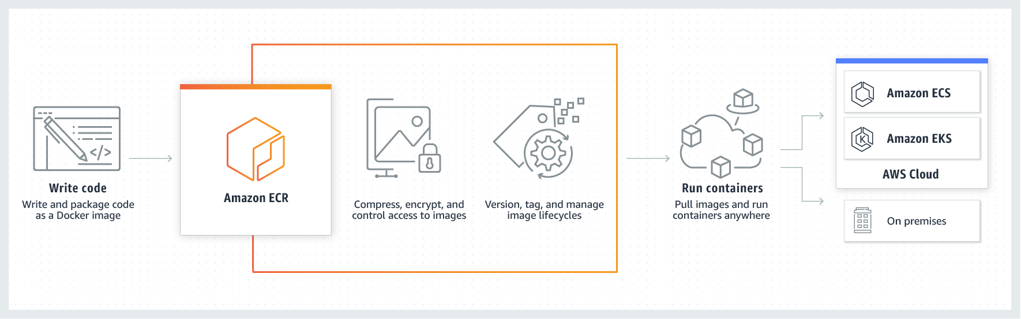
Working of ECR

Slide 4
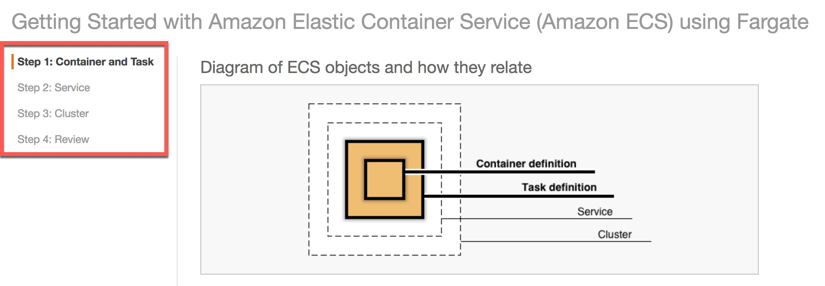
What is ECS (Elastic Container Services)
23
Amazon Elastic Container Service (Amazon ECS) is a highly scalable, fast, container management service that makes it easy to run, stop, and manage Docker containers on a cluster.
Host your cluster on a serverless infrastructure that is managed by Amazon ECS by launching your services or tasks using the Fargate or EC2 launch type.
Launch and Stop containers easily , allows to get state of cluster and gives access to many EC2 features.

Slide 5
Accessing AWS ECS
11
AWS Management Console
AWS Command line tools
Amazon ECS CLI
AWS SDKs

Slide 6
ECS Benefits
Scalable Performance
Very Secure as containers are launched within VPC
Works on highly reliable global infrastructure
Serverless - Fargate provides serverless compute
Optimized for cost

Slide 7
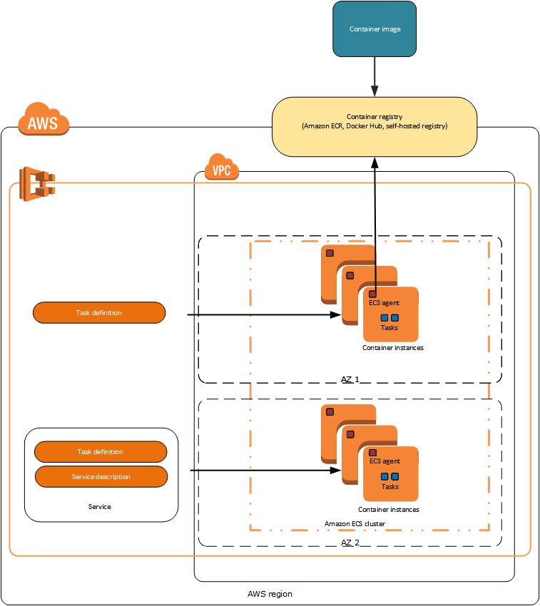
EC2 Launch Type
4

Slide 8
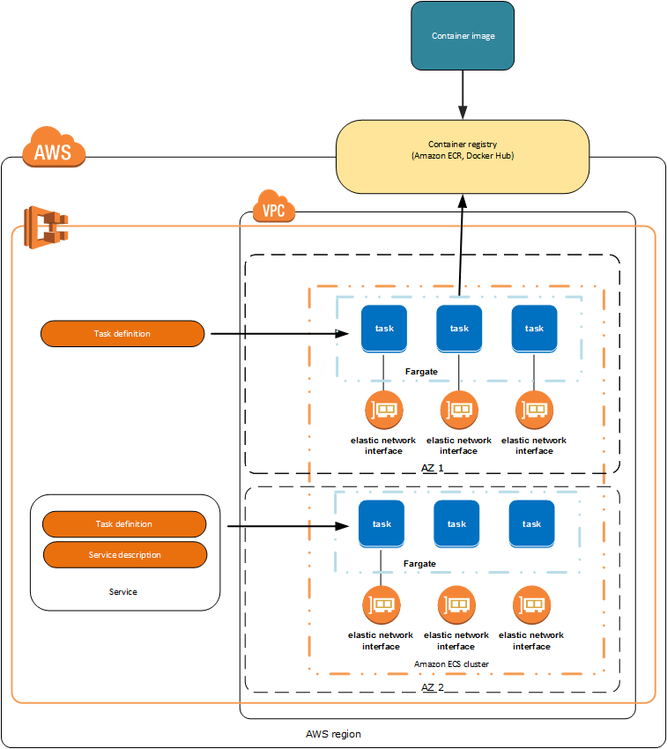
Fargate Launch Type
3

Slide 9
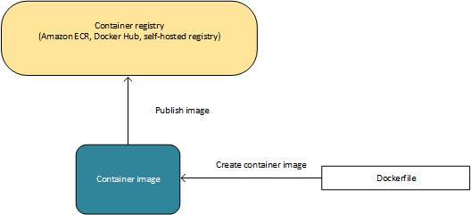
Containers and Images
5

Slide 10
Task Definitions
6
It is a blueprint for your application
The task definition is a text file, in JSON format, that describes one or more containers, up to a maximum of ten, that form your application.
Task definitions specify various parameters for your application.
Examples of task definition parameters are which containers to use, which launch type to use, which ports should be opened for your application, and what data volumes should be used with the containers in the task.

Slide 11
Task Definitions
The following is an example of a task definition containing a single container that runs an NGINX web server using the Fargate launch type
7
The following is an example of a task definition containing a single container that runs an NGINX web server using the Fargate launch type
{
"family": "webserver", "containerDefinitions": [
{
"name": "web",
"image": "nginx",
"memory": "100",
"cpu": "99"
},
],
"requiresCompatibilities": [ "FARGATE"
],
"networkMode": "awsvpc", "memory": "512",
"cpu": "256",
}

Slide 12
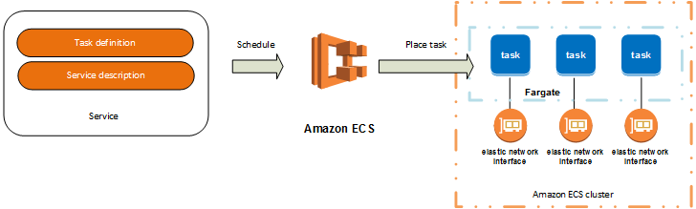
Tasks & Scheduling
8
A task is the instantiation of a task definition within a cluster.
Each task that uses the Fargate launch type has it's own isolation boundary and does not share the underlying kernel, CPU resources, memory resources, or elastic network interface with another task.
Amazon ECS task scheduler is responsible for placing tasks within your cluster.

Slide 13
Clusters & Container Agent
9
Tasks are run using a cluster - logical grouping of resources.
When using the Fargate launch type with tasks within your cluster, Amazon ECS manages your cluster resources.
When using the EC2 launch type, then your clusters are a group of container instances you manage.
An Amazon ECS container instance is an Amazon EC2 instance that is running the Amazon ECS container agent
Amazon ECS downloads your container images from a registry that you specify, and runs those images within your cluster.

Slide 14
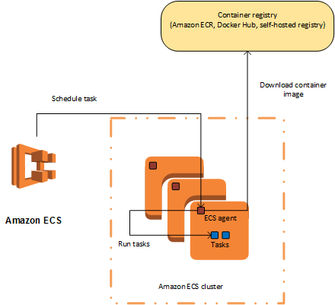
Clusters & Container Agent
10

Slide 15
14
@2018-CHAITANYA R GAAJULA - ALL RIGHTS RESERVED
THANK YOU
THANK YOU

